Slide 1
Creating a Wooden Field Hockey Stick
By: Allison Plante

Slide 2
Topic Selection/Proof of Problem
I play field hockey year round
I have wanted to take a woodworking class but I have been unable
I've been on the throwing team for the past 3 years
I am 6 ft tall, field hockey sticks are supposed to be proportional to your body, mine is not because I am so tall
The largest stick size made is a 38” stick which I currently use but it is not long enough

Slide 3
Mentor
Mr. Brian Grant
Technology Education Teacher
Technology and Education Degree from RIC
Field and Track Coach
I selected Mr. Grant to be my mentor because he is very knowledgeable in the wood shop field and he is my track coach

Slide 4
Core Question
How can a person learn woodworking skills to create a wooden field hockey stick that is tall enough for a six-foot person to use?

Slide 5
Research: Field Hockey Stick
Sports Unlimited. “Field Hockey Stick Buyers Guide.” Sports Unlimited - Shop Sporting Goods and Equipment, 12 Dec. 2014, www.sportsunlimitedinc.com/how-to-buy-a-field-hockey-stick.html.

Slide 6
Research: How to Pick a Field Hockey Stick
Wood field hockey sticks, traditionally made of hickory or mulberry, are mostly used by youth players for their lightweight feel and flexibility.
Stick weight should be based on position.
Backs typically require a heavier stick of 22-24 ounces. The extra weight adds distance to hits and keeps your stick in play during attacks.
“How to Choose a Field Hockey Stick.” PRO TIPS by DICK'S Sporting Goods, 8 Feb. 2017, protips.dickssportinggoods.com/sports-and-activities/more-sports/choosing-a-field-hockey-stick-2.

Slide 7
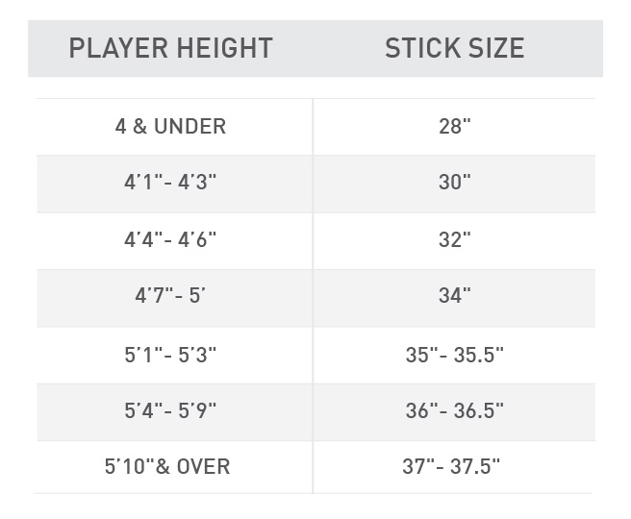
How to Pick a Field Hockey Stick cont.
How to find best stick for your height
Place the index finger of your right hand on your hip bone. Then place your middle and ring finger next to your index finger. The top of your stick should reach the side of your ring finger.
There is no option for 5’10” and over besides 37.5” (38” is available selectively)
“How to Choose a Field Hockey Stick.” PRO TIPS by DICK'S Sporting Goods, 8 Feb. 2017, protips.dickssportinggoods.com/sports-and-activities/more-sports/choosing-a-field-hockey-stick-2.

Slide 8
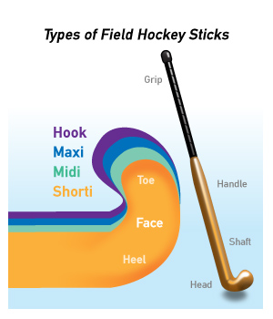
How to Pick a Field Hockey Stick cont.
Types of Heads
4 basic kinds
Shortie, Midi, Maxi, and Hook
Midis are designed for midfield play
provide a larger hitting surface than the shorties, as the shorties are ½ inch smaller
Maxis are designed for defensive play
Combine a larger receiving area with the hitting power of a midi head.
Hooks are J-shaped, with a larger stopping surface for receiving and defensive plays
“How to Choose a Field Hockey Stick.” PRO TIPS by DICK'S Sporting Goods, 8 Feb. 2017, protips.dickssportinggoods.com/sports-and-activities/more-sports/choosing-a-field-hockey-stick-2.
Sports Unlimited. “Field Hockey Stick Buyers Guide.” Sports Unlimited - Shop Sporting Goods and Equipment, 12 Dec. 2014, www.sportsunlimitedinc.com/how-to-buy-a-field-hockey-stick.html.

Slide 9
Research: International Field Hockey Federation Rule Book and Regulations (FIH)
In order for a stick to be legal it must
Weigh 737g or less
Have a total stick length less than 105 cm or 41.3 inches
Pass through a ring with an interior diameter of 51mm
Be rounded on back edges and non playing sides and have a continuous smooth profile
Flat sections along edges not permitted
Rules of Hockey. Lausanne, Switzerland: International Hockey Federation, 2016. Web.http://fih.ch/media/12236728/fih-rules-of-hockey-2017.pdf

Slide 10
International Field Hockey Federation Rule Book and Regulations (FIH) cont.
More specifics the stick must adhere to in order to be legal
Have a head that is “J” or “C” shape
Have a bow that is no larger than 25mm and no smaller than 20mm
Multiple curves are not permitted
The head must be flat on the left hand side only (playing side)
Rules of Hockey. Lausanne, Switzerland: International Hockey Federation, 2016. Web.http://fih.ch/media/12236728/fih-rules-of-hockey-2017.pdf

Slide 11
Research: Cutting a Field Hockey Stick
Wooden stick being cut into many pieces
Shows what the inside compartments of the stick looks like
The video cuts the stick from the toe
This was extremely helpful to see how it was crafted
Provided insights to how I should model the one I created
“What´s inside a timber hockey stick. Field hockey sticks being cut up” Youtube, uploaded by sportsmediagroup, 16 November 2015, https://youtu.be/-WPaxLtXRt4.

Slide 12
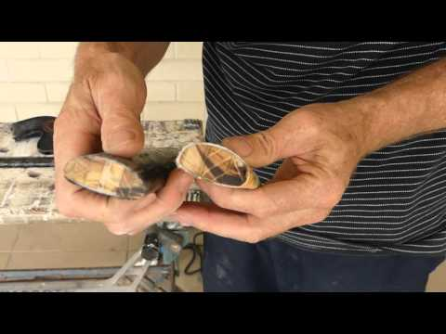
What’s inside a timber field hockey stick
“What´s inside a timber hockey stick. Field hockey sticks being cut up” Youtube, uploaded by sportsmediagroup, 16 November 2015, https://youtu.be/-WPaxLtXRt4.

Slide 13
Research: Woodworking
Using different types of wood results in different textures in the final product
Need to be mindful of choice of wood in projects
Some woods have similar textures and densities
Like maple and mulberry
Some woods need their own techniques to be cut and built properly
Due to way their grain is
“Woodworking.” Funk & Wagnalls New World Encyclopedia, 2017, p. 1p. 1. EBSCOhost, search.ebscohost.com/login.aspx?direct=true&db=funk&AN=WO070000&site=eds-live.

Slide 14
Research: Exploring Woodworking
Band saws are used to create straight or curved pieces of wood
Need to use it to create the hook and bow of the stick
There are 5 key parts to a bandsaw
Blade, Table, Table Insert, Power Switch, and Upper Blade Guide
You can not cut smaller than the given blade width
McWard, Larry. “Bandsaws”. Exploring Woodworking. 1993.

Slide 15
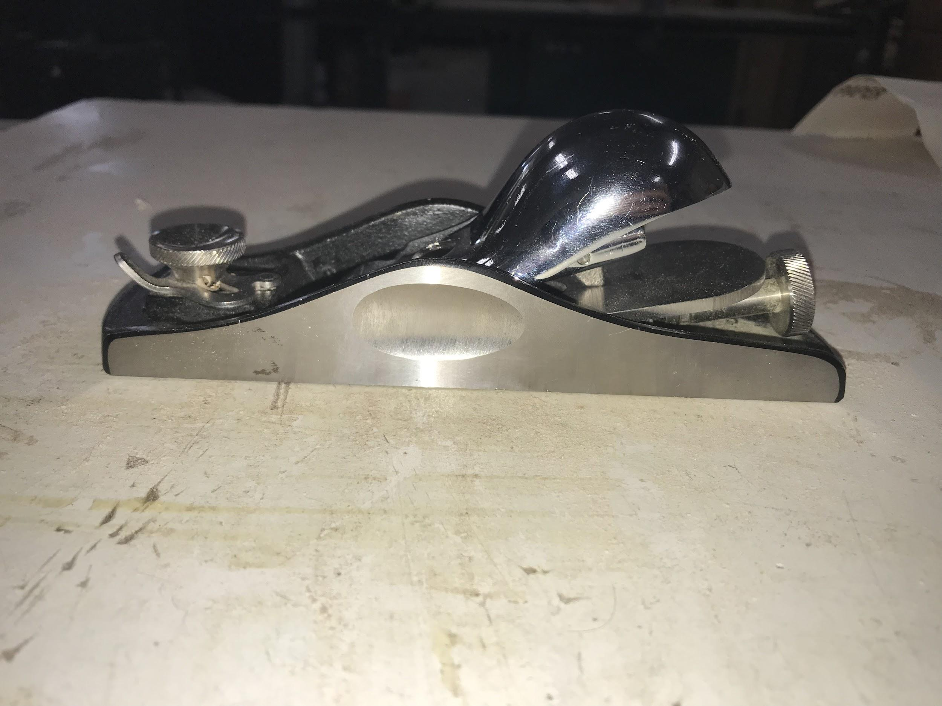
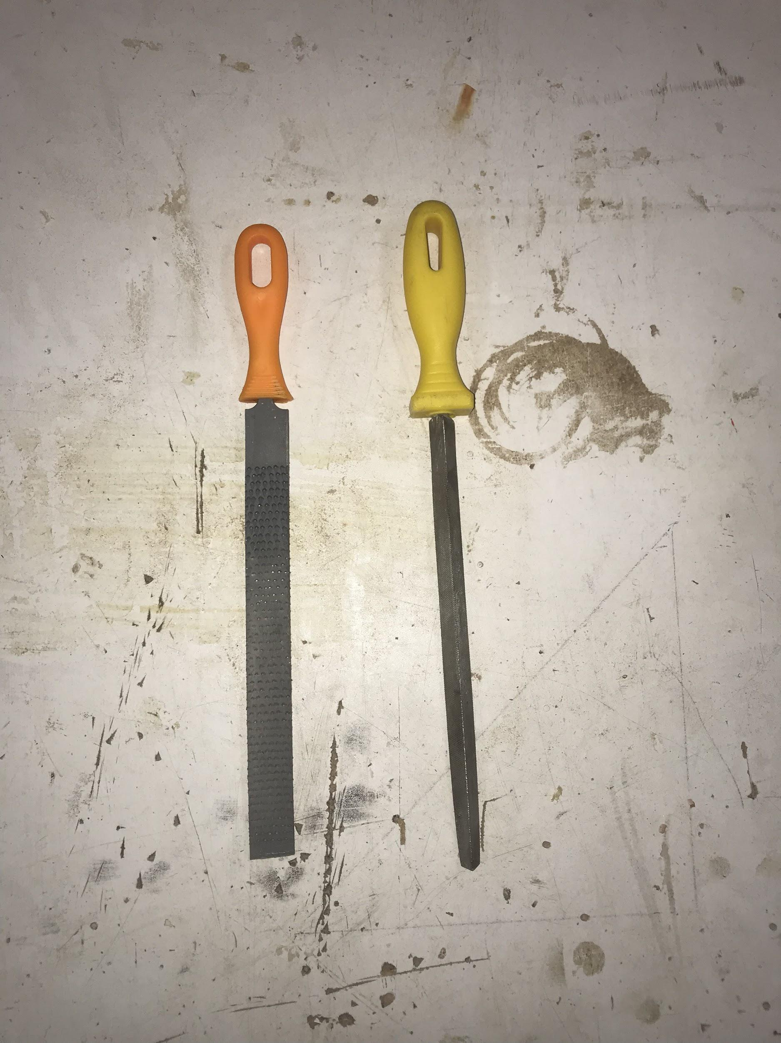
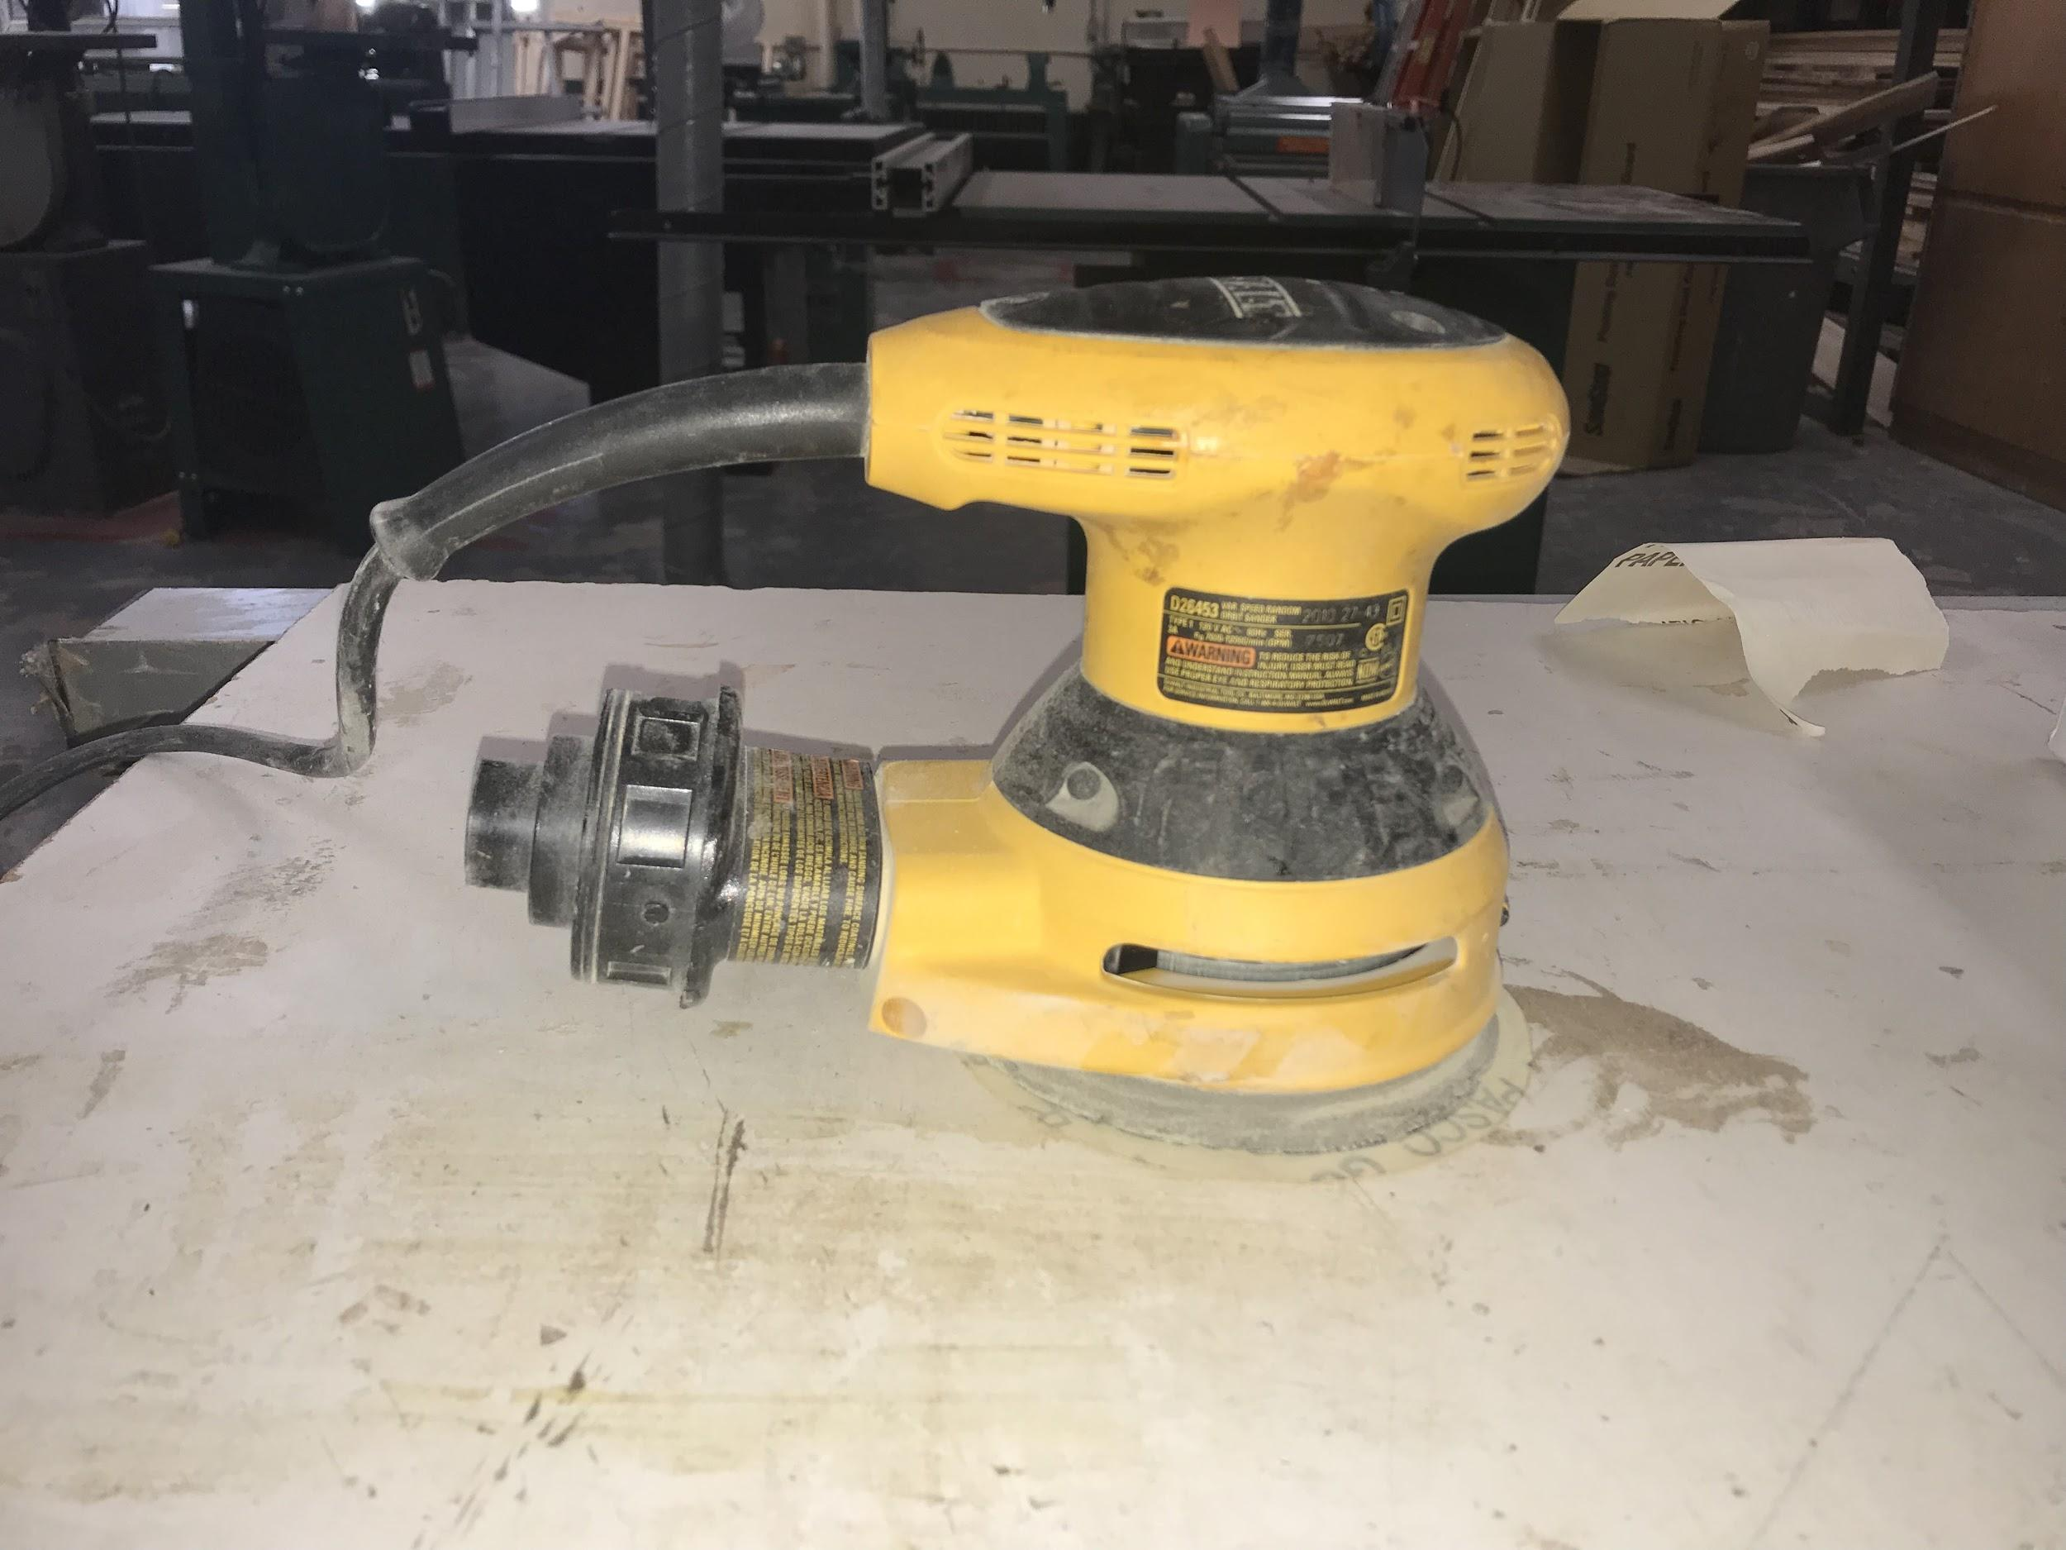
Research: Woodworking
There are several types of saws to use
Stationary power tools
Bandsaw
Belt sander
Hand sander
Hand Tools used
Spokeshave
Block Plane
Files
“Woodworking.” Funk & Wagnalls New World Encyclopedia, 2017, p. 1p. 1. EBSCOhost, search.ebscohost.com/login.aspx?direct=true&db=funk&AN=WO070000&site=eds-live.

Slide 16
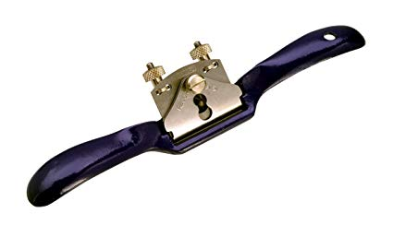
Spokeshave
A spokeshave is a hand tool used in woodworking
to shave curved pieces of wood down to
the required size
Wonkee Donkee Editors. “What Is a Spokeshave?” Wonkee Donkee, 2018, www.wonkeedonkeetools.co.uk/spokeshaves/what-is-a-spokeshave/.
https://www.amazon.in/Irwin-Record-Malleable-Adjustable-Spokeshave/dp/B0000DD1KK

Slide 17
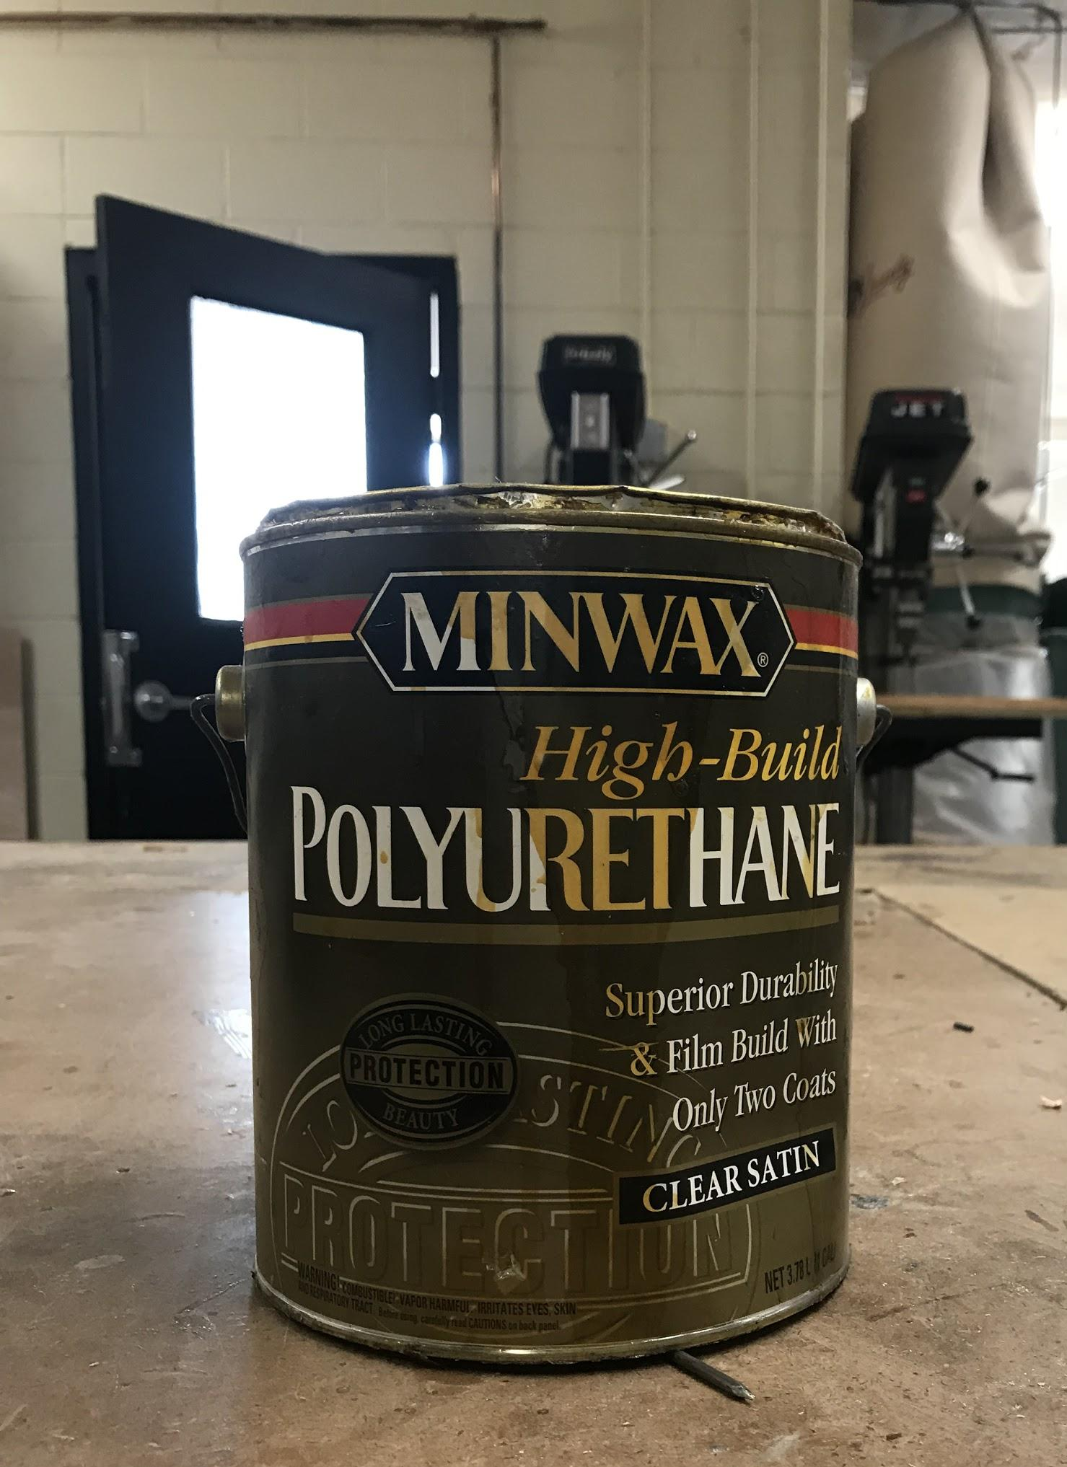
Woodworking cont.
Finishing
The object is finished when it is smooth
Smoothed with sandpaper or steel wool
Removes any imperfections made by the
power tools while it is being built
One or more finishes are applied to protect the wood, highlight the grain, or cover up imperfections not fixed by the sandpaper.
Used a durable polyurethane satin finish
“Woodworking.” Funk & Wagnalls New World Encyclopedia, 2017, p. 1p. 1. EBSCOhost, search.ebscohost.com/login.aspx?direct=true&db=funk&AN=WO070000&site=eds-live.

Slide 18
Core Question
How can a person learn woodworking skills to create a wooden field hockey stick that is tall enough for a six-foot person to use?

Slide 19
Answer to Core Question
Building a 41” wooden field hockey stick

Slide 20
Learning Stretch/Application of Learning
Learned a new skill
Wood working
Made a Product
41 inch field hockey stick
New appreciation for anything wooden
Experienced first hand how difficult it is to make a piece perfect both aesthetically and functionally

Slide 21
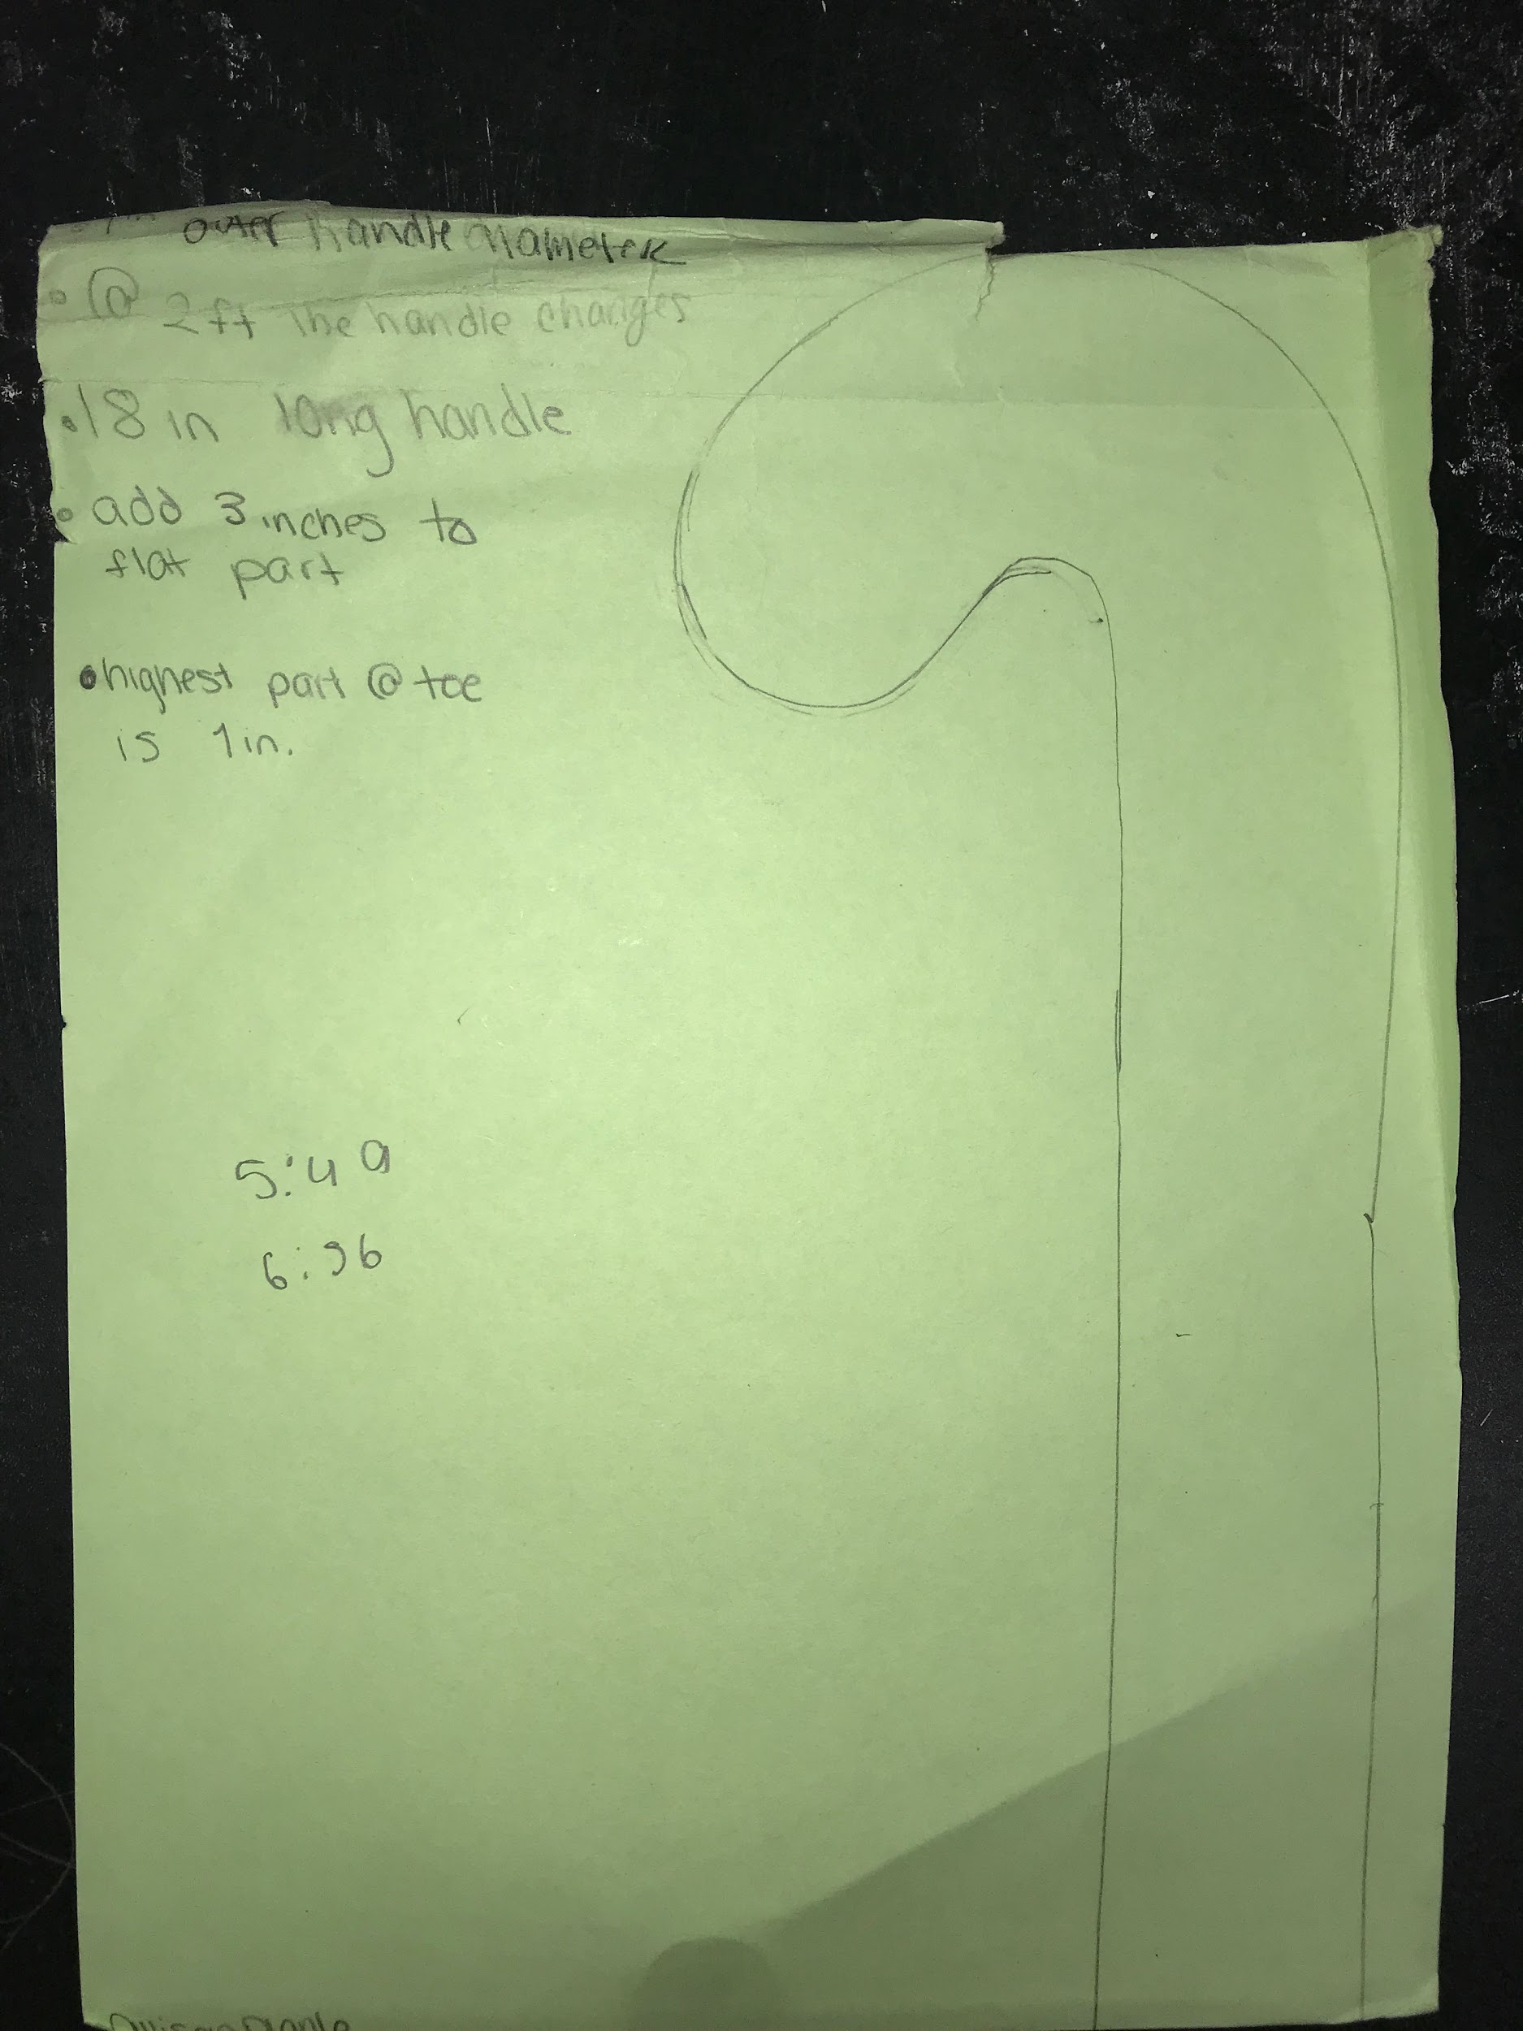
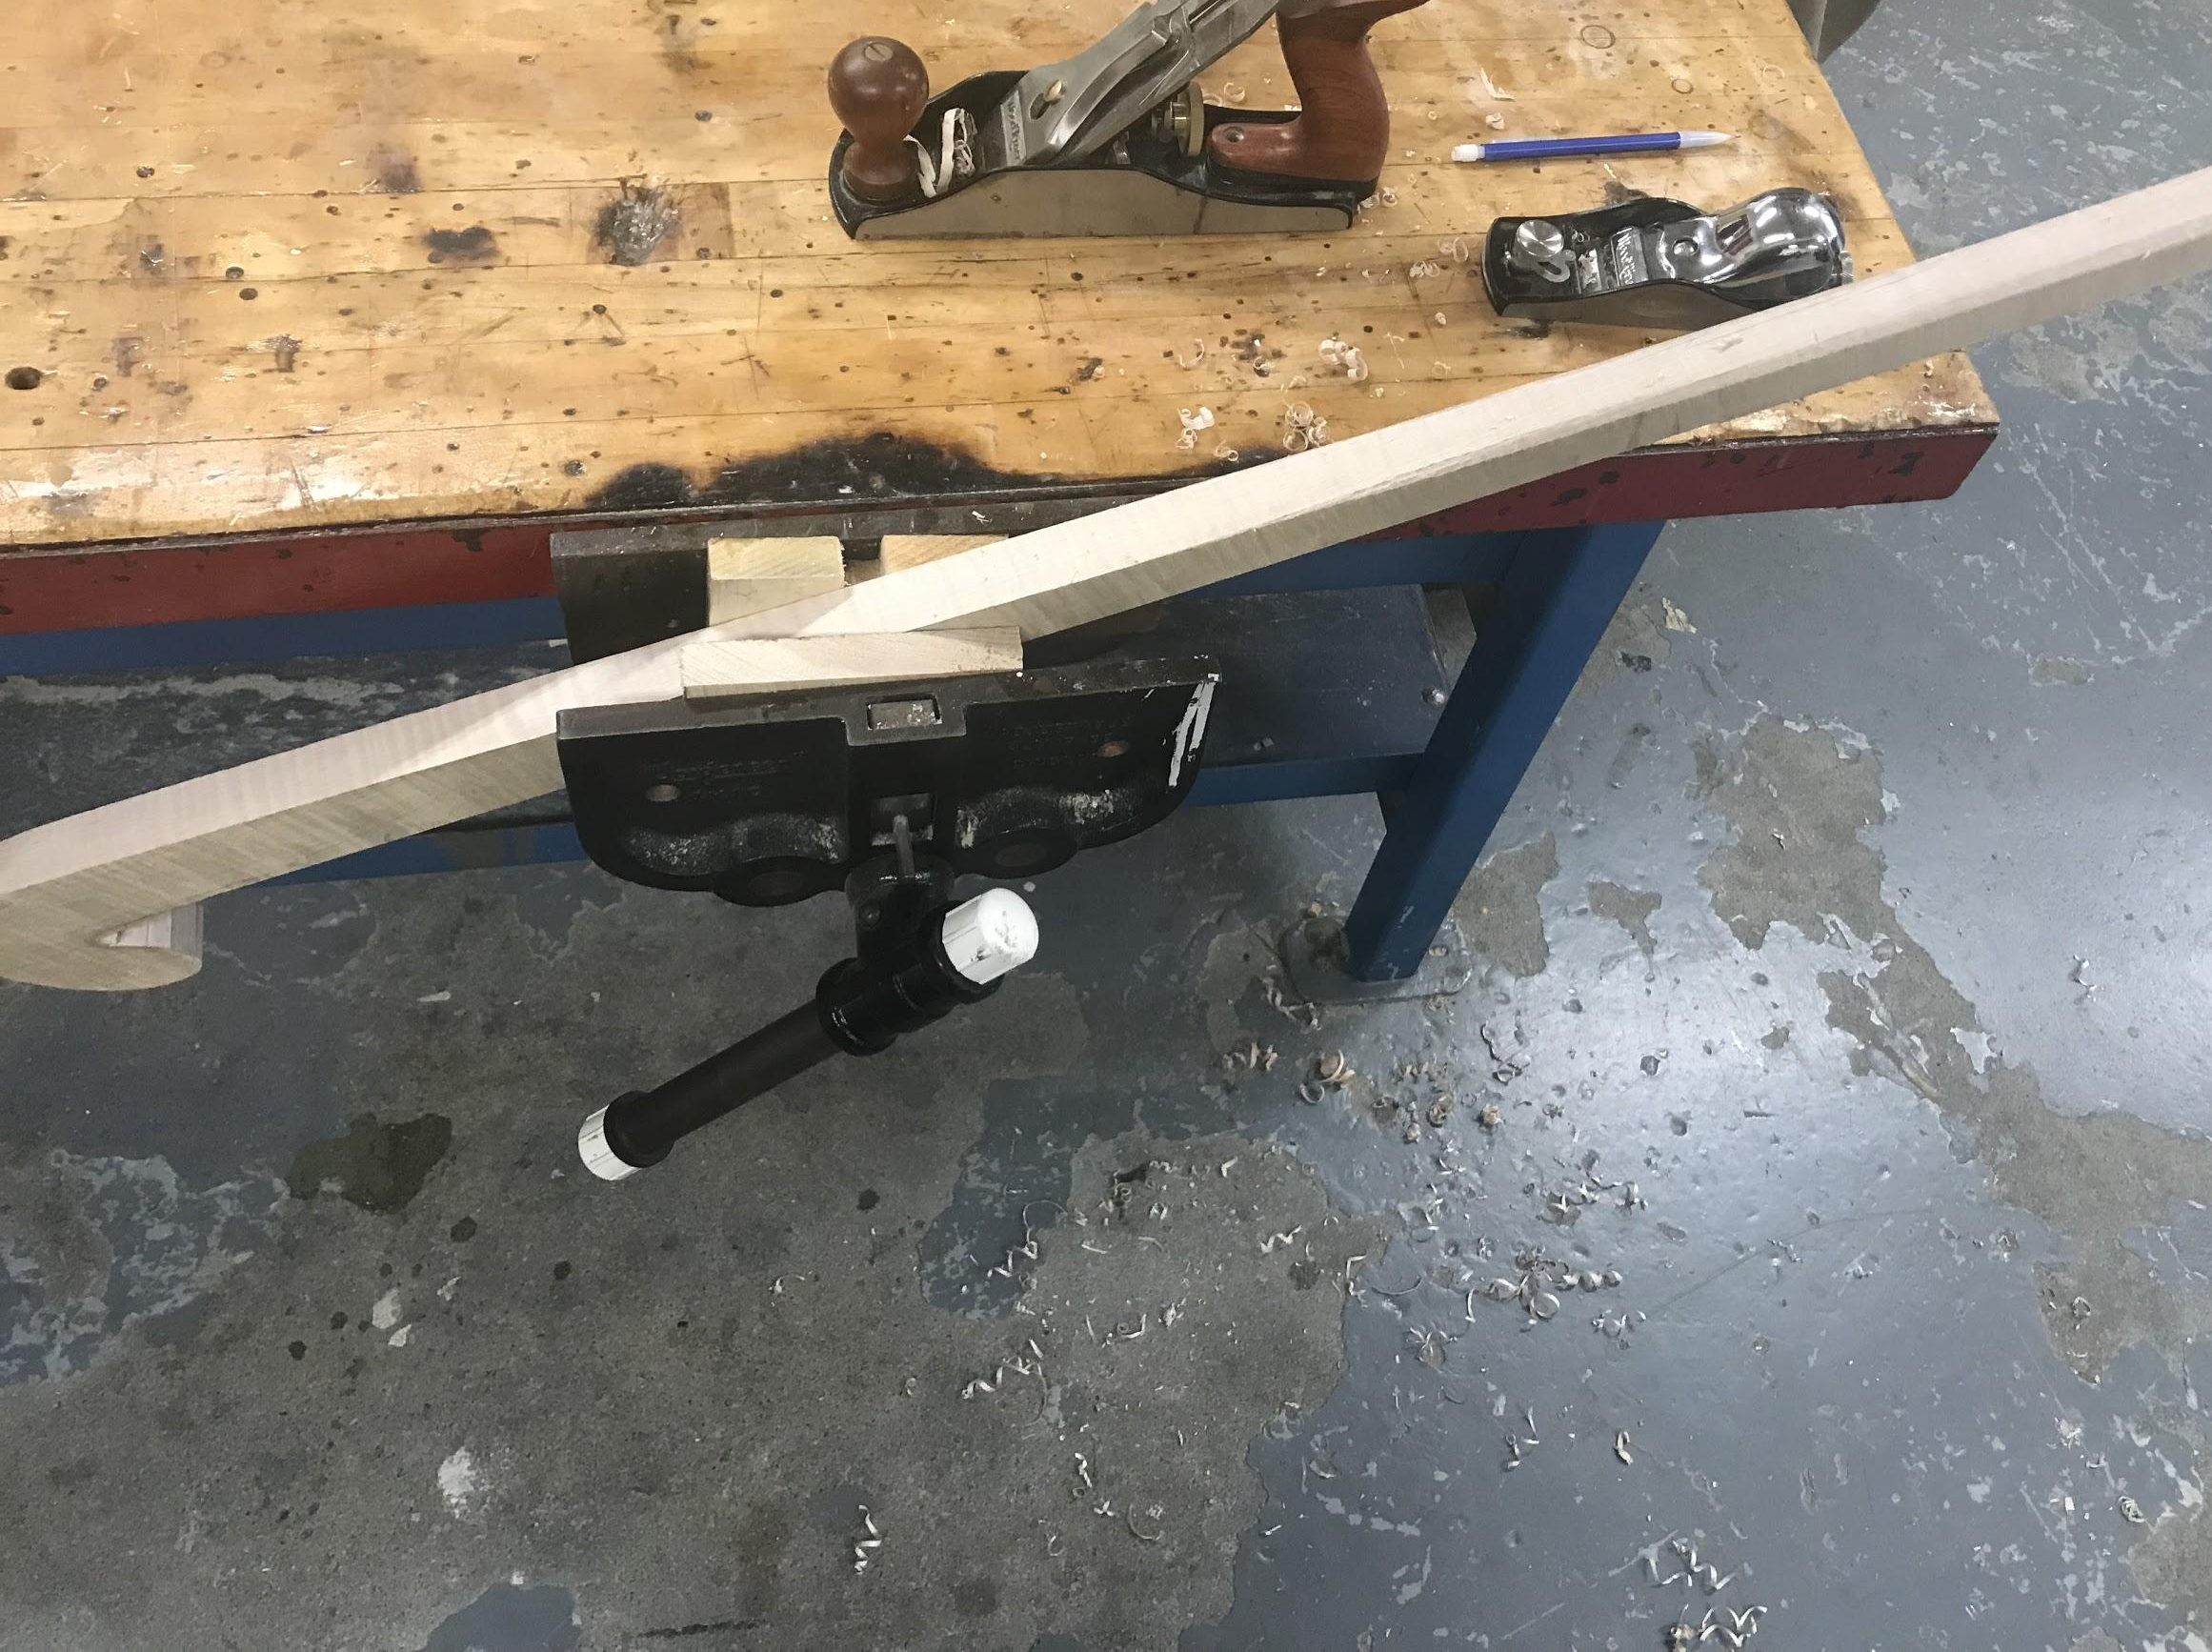
Evidence of New Knowledge
Rough Draft
Rough cut after Bandsaw

Slide 22
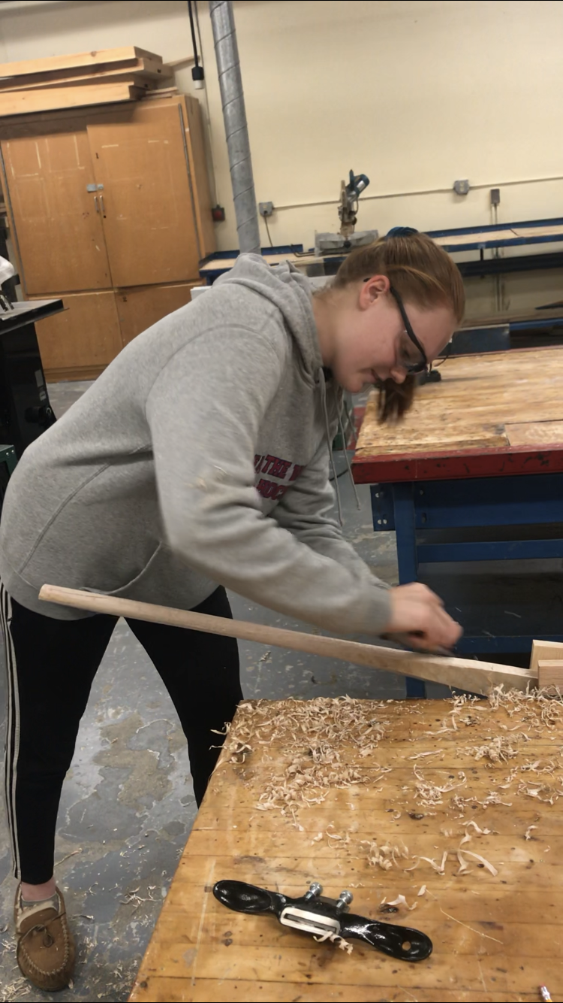
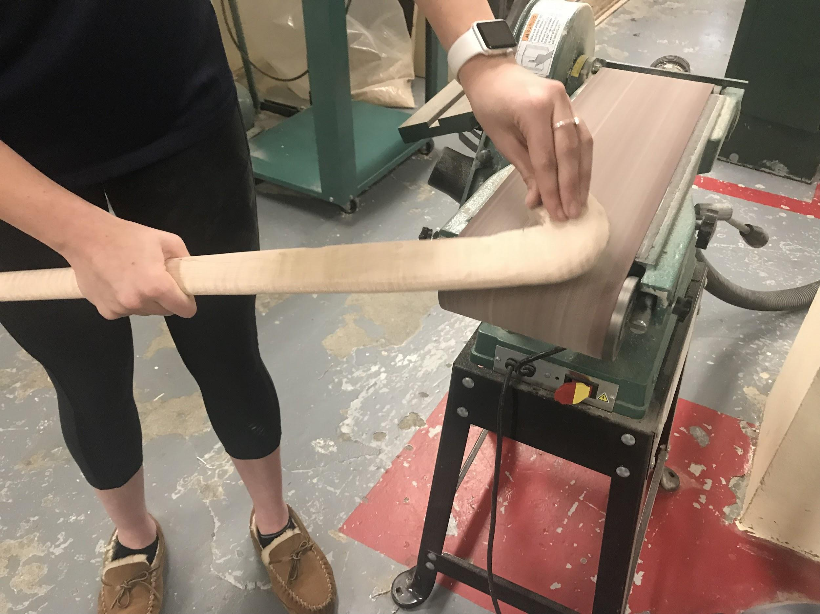
Evidence of New Knowledge
Using the spokeshave
Belt Sander

Slide 23
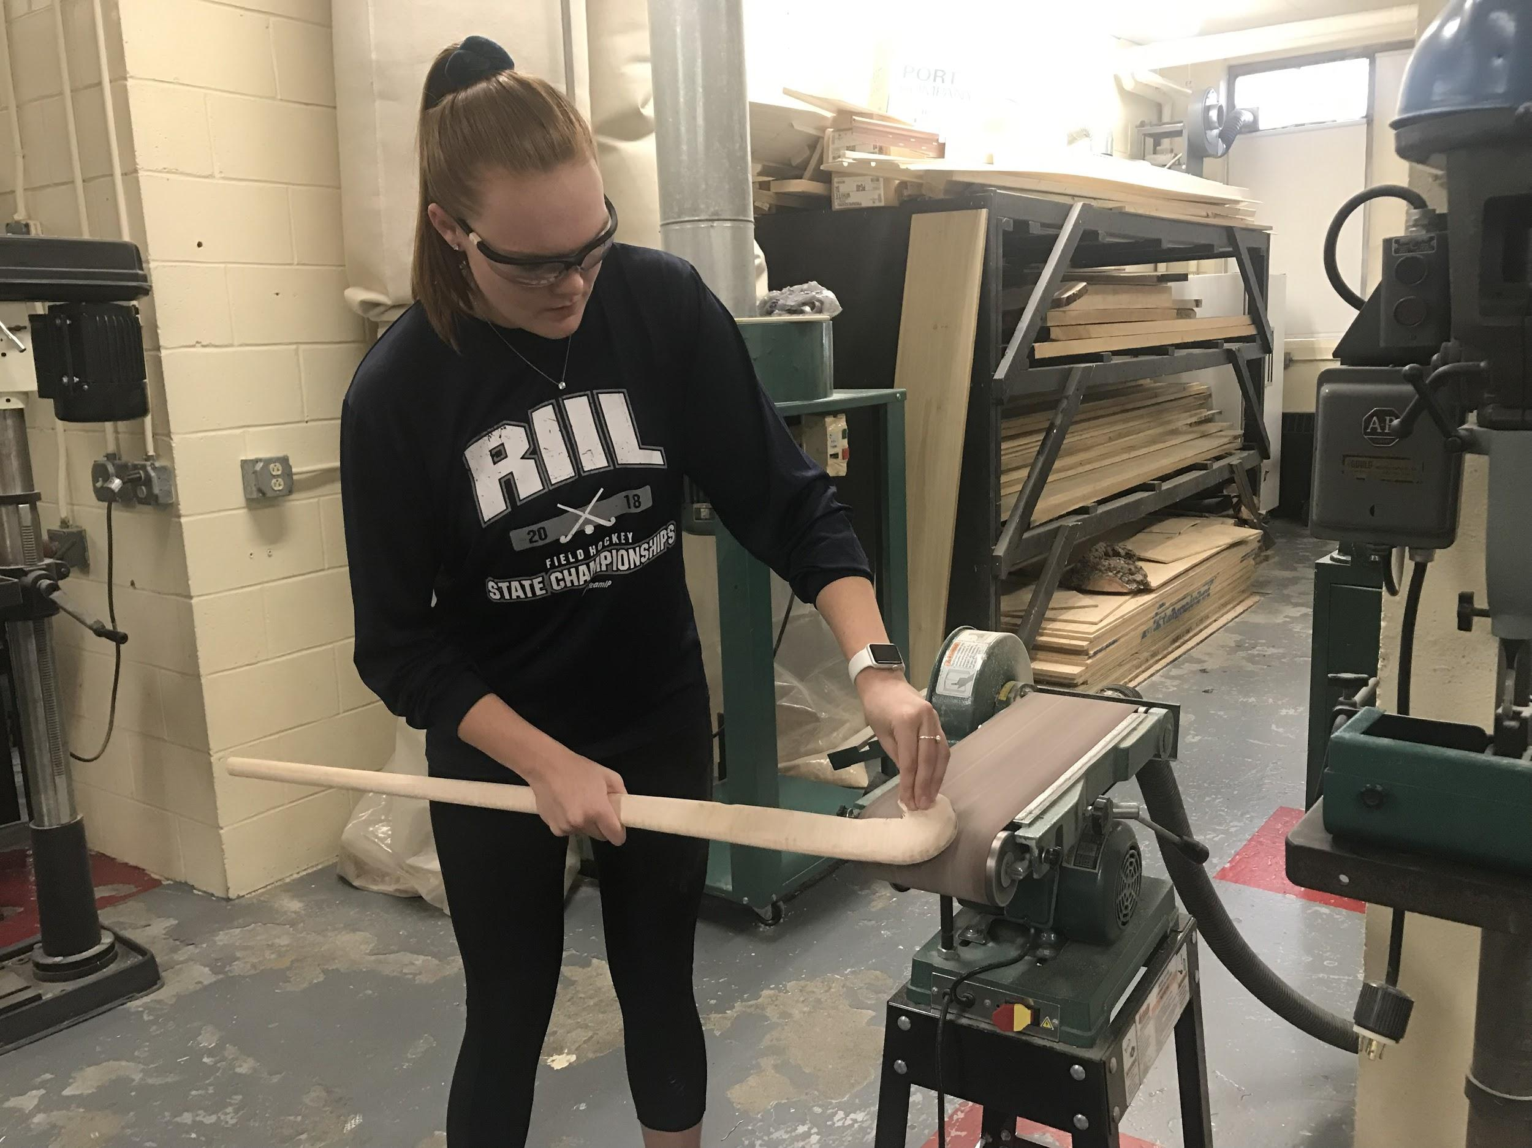
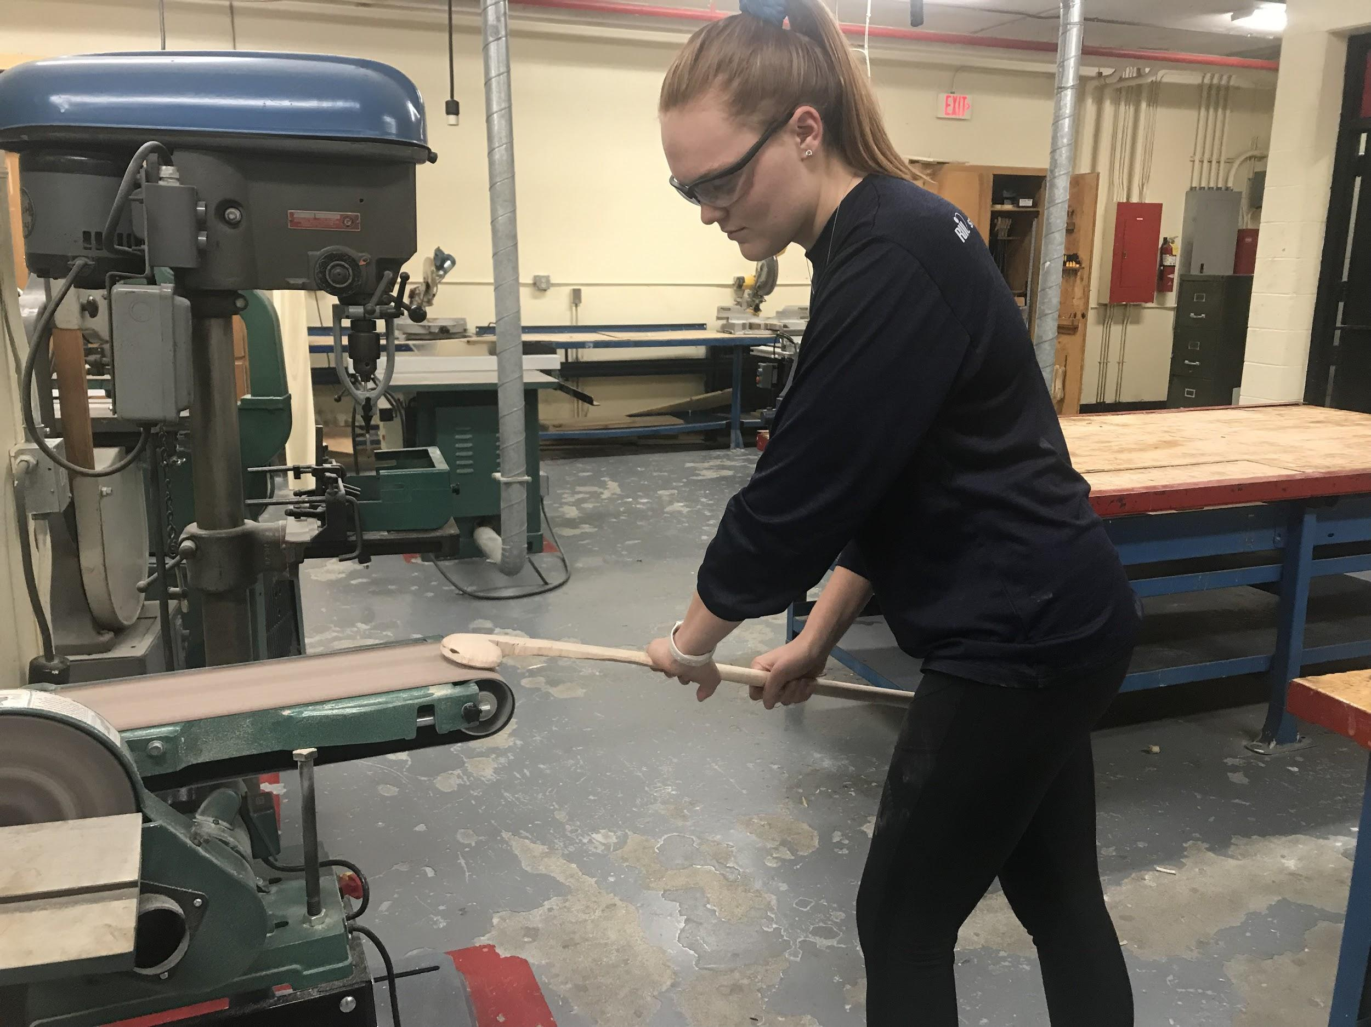
Evidence of New Knowledge
Belt Sander

Slide 24
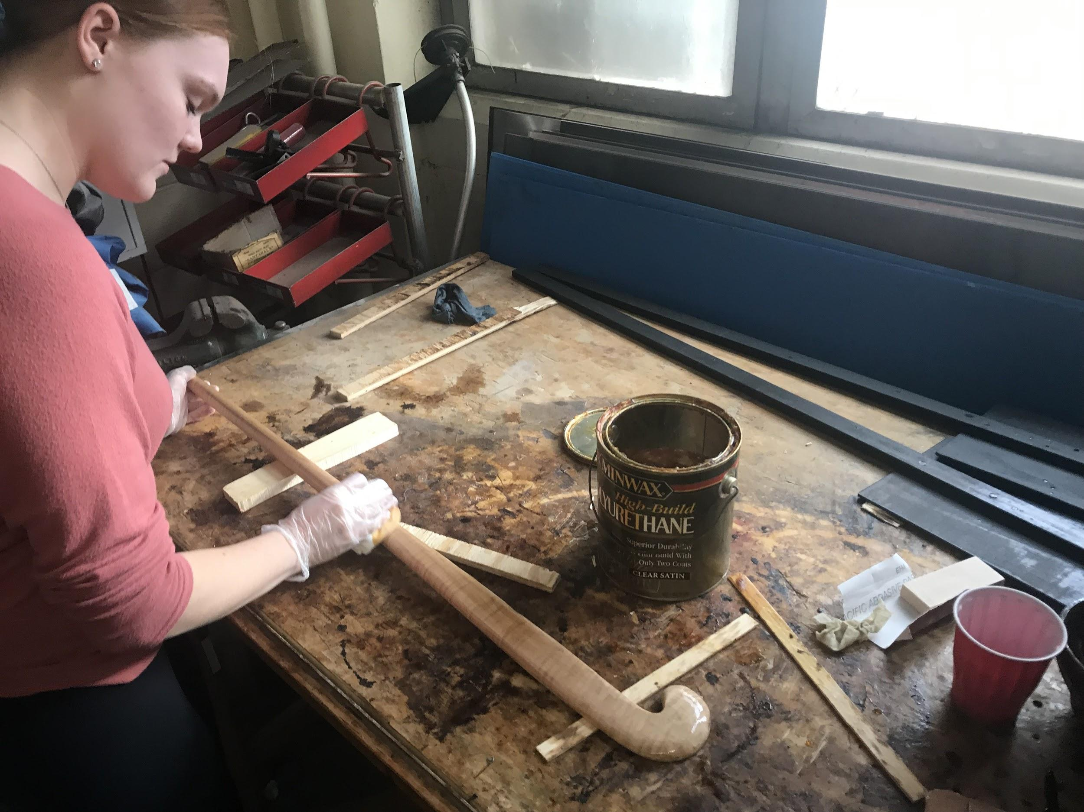
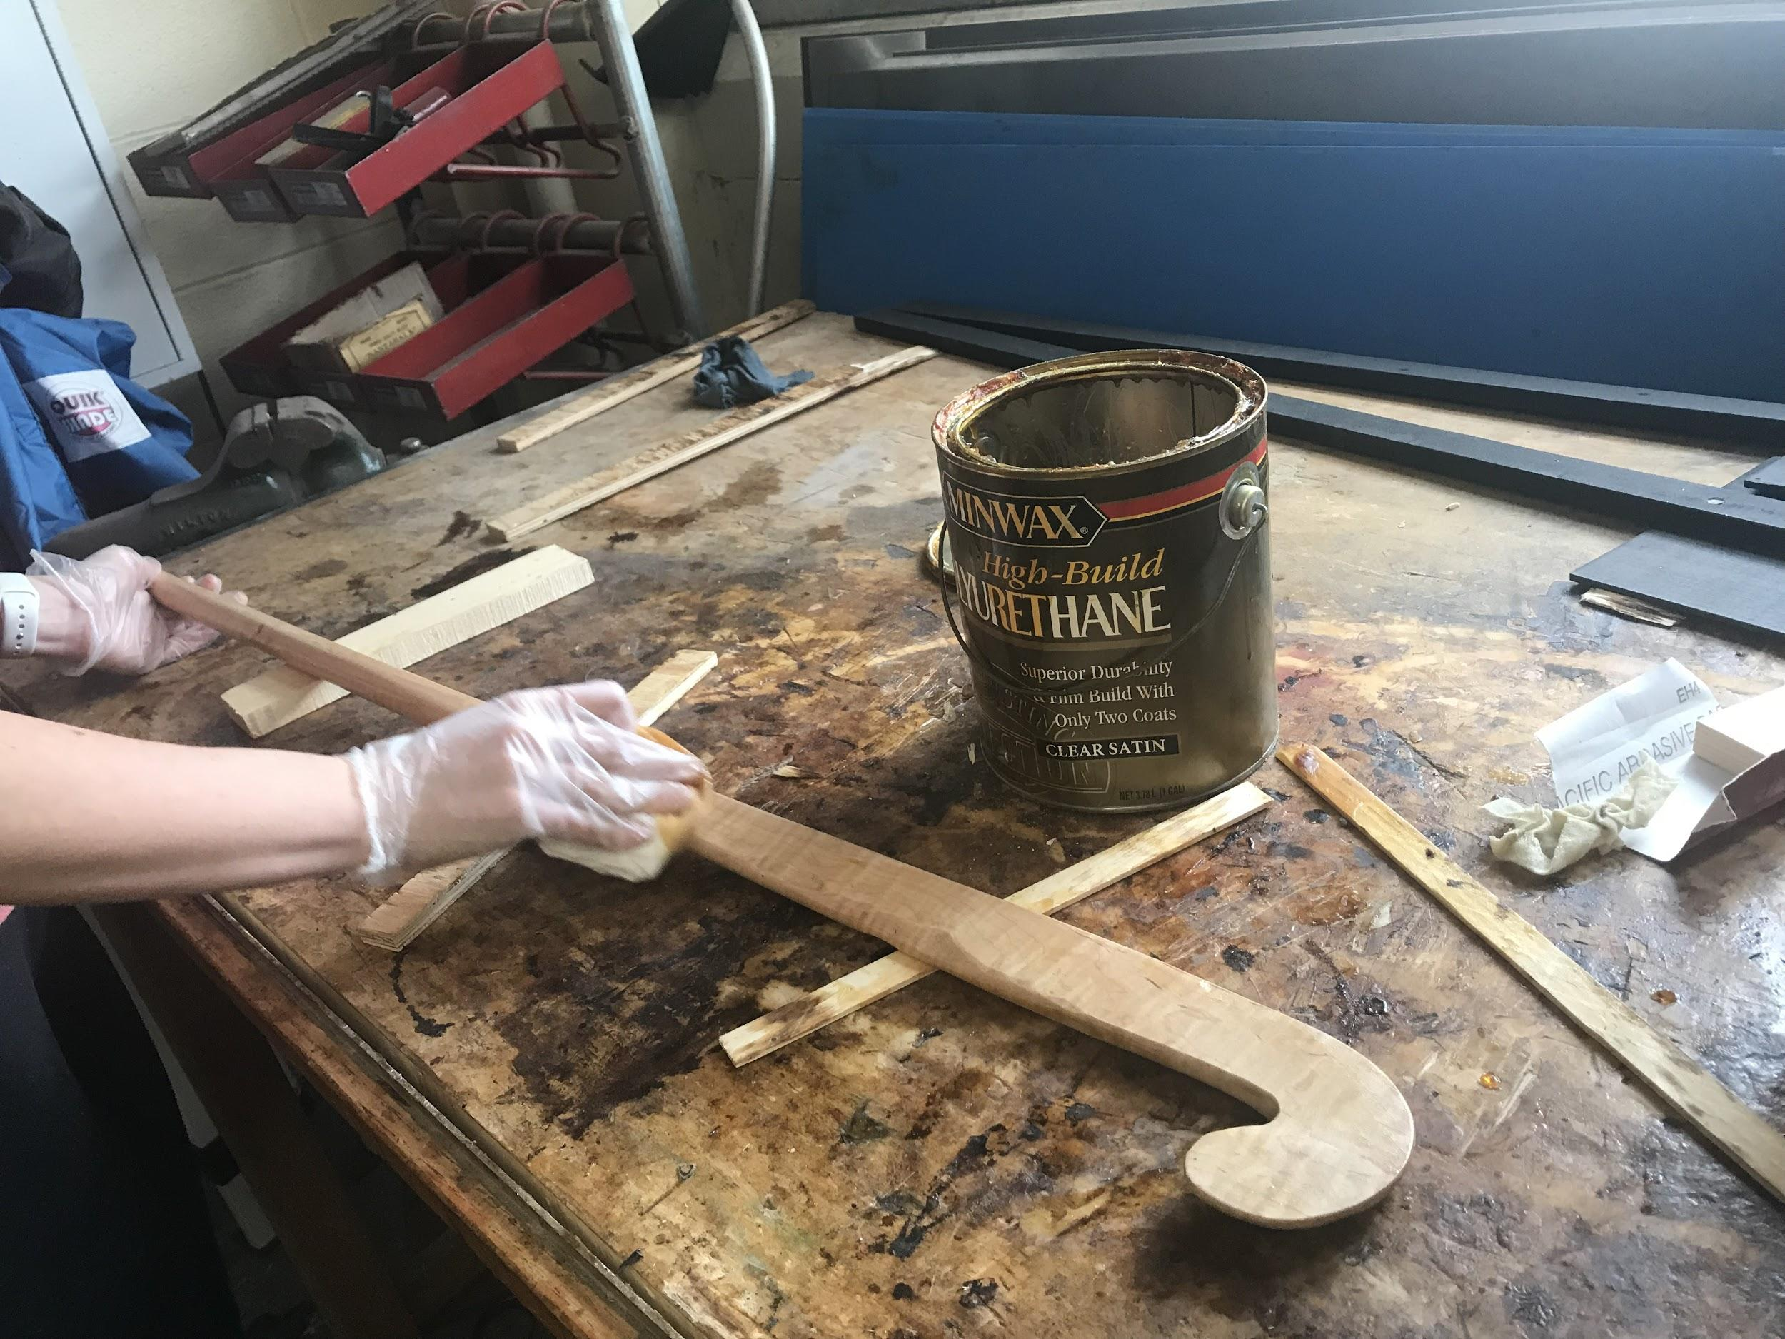
Evidence of New Knowledge
First coat of polyurethane
Second coat of polyurethane

Slide 25
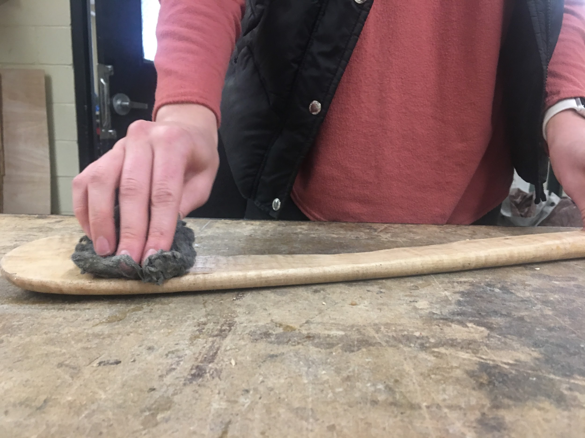
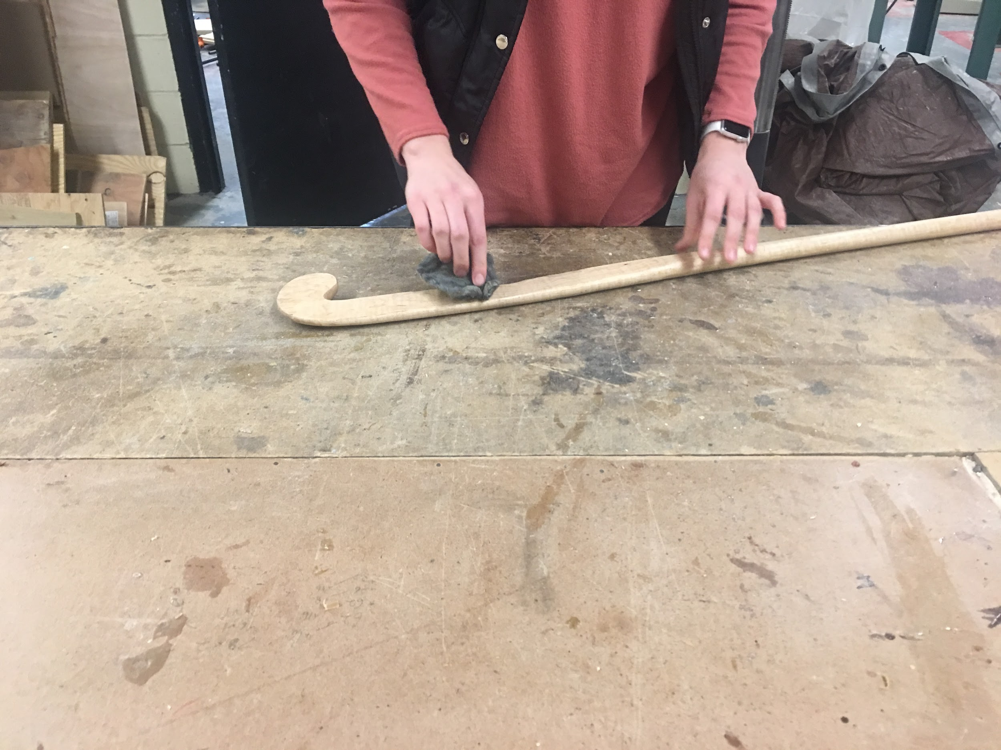
Evidence of New Knowledge
Using steel wool after the first coat
Using steel wool after second coat

Slide 26
Works Cited
“What’s inside a timber hockey stick. Field hockey sticks being cut up” Youtube, uploaded by sportsmediagroup, 16 November 2015, https://youtu.be/-WPaxLtXRt4.
Rules of Hockey. Lausanne, Switzerland: International Hockey Federation, 2016.
McWard, Larry. “Bandsaws”. Exploring Woodworking. 1993. Pg 54-56
“How to Choose a Field Hockey Stick.” PRO TIPS by DICK'S Sporting Goods, 8 Feb. 2017, protips.dickssportinggoods.com/sports-and-activities/more-sports/choosing-a-field-hockey-stick-2.
“Woodworking.” Funk & Wagnalls New World Encyclopedia, 2017, p. 1p. 1. EBSCOhost, search.ebscohost.com/login.aspx?direct=true&db=funk&AN=WO070000&site=eds-live.
Wonkee Donkee Editors. “What Is a Spokeshave?” Wonkee Donkee, 2018, www.wonkeedonkeetools.co.uk/spokeshaves/what-is-a-spokeshave/.
https://www.amazon.in/Irwin-Record-Malleable-Adjustable-Spokeshave/dp/B0000DD1KK

